Slide 1
Schema Refinement and Normal Forms
courtesy of Joe Hellerstein for some slides
Jianlin Feng
School of Software
SUN YAT-SEN UNIVERSITY
Notes:
1

Slide 2
Review: Database Design
Requirements Analysis
  user needs; what must database do?
Conceptual Design
  high level description (often done with ER model)
Logical Design
  translate ER into DBMS data model
Schema Refinement
  consistency, normalization
Physical Design - indexes, disk layout
Security Design - who accesses what

Slide 3
The Evils of Redundancy
Redundancy is at the root of several problems associated with relational schemas:
  redundant storage, insert/delete/update anomalies
Integrity constraints, in particular functional dependencies, can be used to identify schemas with such problems and to suggest refinements.
Main refinement technique: decomposition
  replacing ABCD with, say, AB and BCD, or ACD and ABD.
Decomposition should be used judiciously:
  Is there reason to decompose a relation?
  What problems (if any) does the decomposition cause?

Slide 4
Functional Dependencies (FDs)
A functional dependency X → Y holds over relation schema R if, for every allowable instance r of R:
  t1 ∈ r, t2 ∈ r, π_{X} (t1) = π_{X} (t2)
  implies π_{Y} (t1) = π_{Y} (t2)
  (where t1 and t2 are tuples;X and Y are sets of attributes)
In other words: X → Y means
  Given any two tuples in r, if the X values are the same, then the Y values must also be the same. (but not vice versa)
Can read “→” as “determines”

Slide 5
Functional Dependencies (Contd.)
An FD is a statement about all allowable relations.
  Must be identified based on semantics of application.
  Given some instance r1 of R, we can check if r1 violates some FD f, but we cannot determine if f holds over R.
Question: How related to keys?
  if “K → all attributes of R” then K is a superkey for R
    (does not require K to be minimal.)
FDs are a generalization of keys.

Slide 6
Example: Constraints on Entity Set
Consider relation obtained from Hourly_Emps:
Hourly_Emps (ssn, name, lot, rating, wage_per_hr, hrs_per_wk)
We sometimes denote a relation schema by listing the attributes: e.g., SNLRWH
Sometimes, we refer to the set of all attributes of a relation by using the relation name. e.g., “Hourly_Emps” for SNLRWH
What are some FDs on Hourly_Emps?
  ssn is the key: S → SNLRWH
  rating determines wage_per_hr: R → W
  lot determines lot: L → L (“trivial” dependnency)

Slide 7
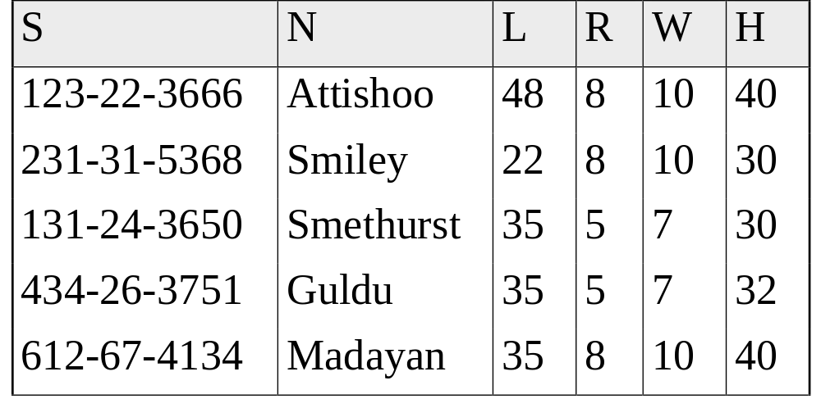
Problems Due to R → W
Hourly_Emps
Update anomaly: Can we modify W in only the 1st tuple of SNLRWH?
Insertion anomaly: What if we want to insert an employee and don’t know the hourly wage for his or her rating? (or we get it wrong?)
Deletion anomaly: If we delete all employees with rating 5, we lose the information about the wage for rating 5!

Slide 8
Detecting Redundancy
Hourly_Emps
Q: Why was R → W problematic, but S →W not?

Slide 9
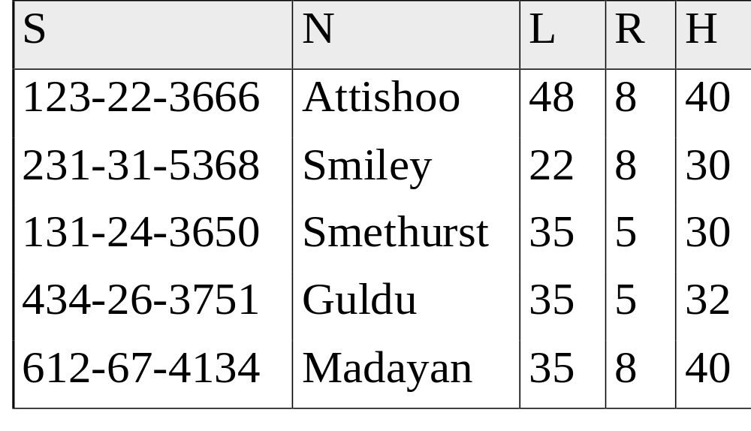
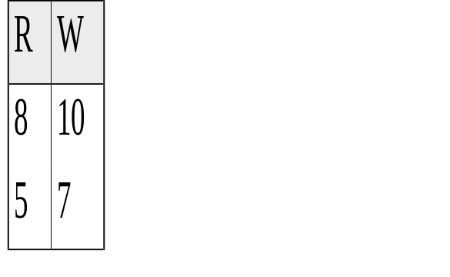
Decomposing a Relation
Redundancy can be removed by “chopping” the relation into pieces.
FD’s are used to drive this process.
  R → W is causing the problems, so decompose SNLRWH into what relations?
Wages
Hourly_Emps2

Slide 10
Refining an ER Diagram by FD: Attributes Can Easily Be Associated with the “Wrong” Entitity Set in ER Design.
1st diagram becomes: Workers(S,N,L,D,Si) Departments(D,M,B)
  Lots associated with workers.
Suppose all workers in a dept are assigned the same lot: D → L
Redundancy; fixed by decomposition: Workers2(S,N,D,Si) Dept_Lots(D,L) Departments(D,M,B)
Can fine-tune this: Workers2(S,N,D,Si) Departments(D,M,B,L)
Before:
since
name
dname
ssn
lot
did
budget
Employees
Works_In
Departments
After:
budget
since
name
dname
ssn
did
lot
Employees
Works_In
Departments

Slide 11
Reasoning About FDs
Given some FDs, we can usually infer additional FDs:
  title → studio, star implies title → studio and title → star
  title → studio and title → star implies title → studio, star
  title → studio, studio → star implies title → star
  But, title, star → studio does NOT necessarily imply that title → studio or that star → studio
An FD f is implied by a set of FDs F if f holds whenever all FDs in F hold.
F⁺ = closure of F is the set of all FDs that are implied by F. (includes “trivial dependencies”)

Slide 12
Rules of Inference
Armstrong’s Axioms (X, Y, Z are sets of attributes):
  Reflexivity: If X ⊇ Y, then X → Y
  Augmentation: If X → Y, then XZ → YZ for any Z
  Transitivity: If X → Y and Y → Z, then X → Z
These are sound and complete inference rules for FDs!
  i.e., using AA you can compute all the FDs in F+ and only these FDs.
Some additional rules (that follow from AA):
  Union: If X → Y and X → Z, then X → YZ
  Decomposition: If X → YZ, then X → Y and X → Z

Slide 13
Example
Contracts(cid,sid,jid,did,pid,qty,value), and:
  C is the key: C → CSJDPQV
  P(roject) purchases a given part using a single contract: JP → C
  D(ept) purchases at most 1 part from a supplier: SD → P
Problem: Prove that SDJ is a key for Contracts
  JP → C, C → CSJDPQV imply JP → CSJDPQV
    (by transitivity) (shows that JP is a key)
  SD → P implies SDJ → JP (by augmentation)
  SDJ → JP, JP → CSJDPQV imply SDJ → CSJDPQV (by transitivity) thus SDJ is a key.

Slide 14
Attribute Closure
Typically, we just want to check if a given FD X → Y is in the closure of a set of FDs F. An efficient check:
  Compute attribute closure of X (denoted X⁺) w.r.t. F. X⁺ = Set of all attributes A such that X → A is in F⁺
    X⁺ := X
    Repeat until no change: if there is an FD U → V in F such that U is in X⁺, then add V to X⁺
  Check if Y is in X⁺
The approach can also be used to find the keys of a relation.
  If all attributes of R are in the closure of X, then X is a superkey for R.

Slide 15
Attribute Closure (example)
R = {A, B, C, D, E}
F = { B →CD, D → E, B → A, E → C, AD →B }
Is B → E in F⁺ ?
B⁺ = B
  B⁺ = BCD
  B⁺ = BCDA
  B⁺ = BCDAE … Yes! and B is a key for R too!
Is D a key for R?
  D⁺ = D
  D⁺ = DE
  D⁺ = DEC
  … Nope!
Is AD a key for R? AD⁺ = AD
AD⁺ = ABD and B is a key, so Yes!
Is AD a candidate key for R?
  A⁺ = A
  A not a key, nor is D so Yes!
Is ADE a candidate key for R?
No! AD is a key, so ADE is a superkey, but not a candidate key.

Slide 16
Normal Forms
How to do schema refinement?
  We use normal forms as guidance.
If a relation is in a normal form (BCNF, 3NF etc.):
  we know that certain problems are avoided/minimized.
  helps decide whether decomposing a relation is useful.

Slide 17
Normal Forms vs. Functional Dependencies
Role of FDs in detecting redundancy:
  Consider a relation R with 3 attributes, ABC.
    No (non-trivial) FDs hold: There is no redundancy here.
    Given A → B: If A is not a key, then several tuples could have the same A value, and if so, they’ll all have the same B value!
The normal forms based on FDs are:
  First Normal Form (1NF), 2NF, 3NF, and Boyce-Codd Normal Form (BCNF)
  These forms have increasingly restrictive requirements:
    1^{NF} ⊃ 2NF (of historical interest) ⊃ 3NF ⊃ BCNF

Slide 18
1st Normal Form
1st Normal Form – all attributes are atomic
  Given a relation R in 1NF, for a tuple t of R, t’s every attribute can contain only atomic values,
  i. e., attribute values are not lists or sets.
We can imagine there exists FDs in the following manner:
  Attribute A → some unique value in A’s domain.

Slide 19
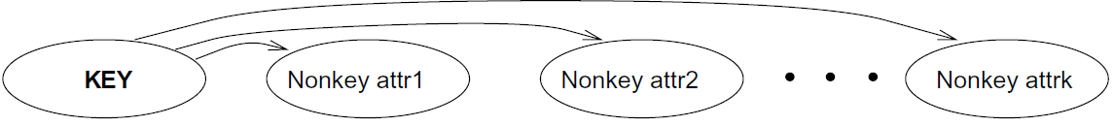
Boyce-Codd Normal Form (BCNF)
Relation R with FDs F is in BCNF if for all X → A in F⁺
  A ∈ X (called a trivial FD), or
  X is a superkey for R.
Intuitively, R is in BCNF if the only non-trivial FDs over R are key constraints.

Slide 20
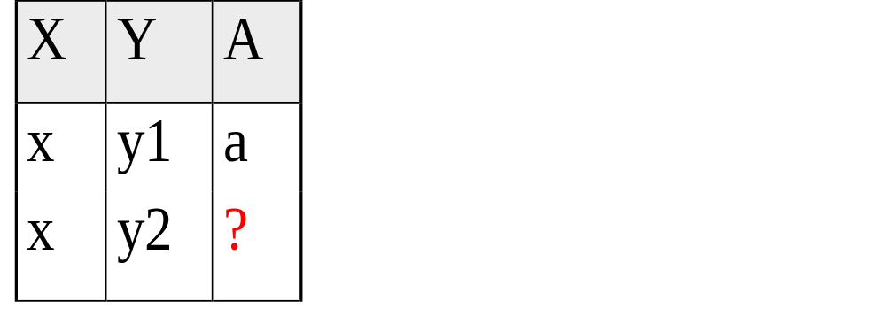
Boyce-Codd Normal Form (Contd.)
If R in BCNF, then every field of every tuple records information that cannot be inferred using FDs alone.
  Say we know FD X → A holds for this example relation:
Can you guess the value of the missing attribute?
Yes, so relation is not in BCNF

Slide 21
Decomposition of a Relation Scheme
If a relation is not in a desired normal form, it can be decomposed into multiple relations that each are in that normal form.
Suppose that relation R contains attributes A1 ... An. A decomposition of R consists of replacing R by two or more relations such that:
  Each new relation scheme contains a subset of the attributes of R,
  and every attribute of R appears as an attribute of at least one of the new relations.

Slide 22
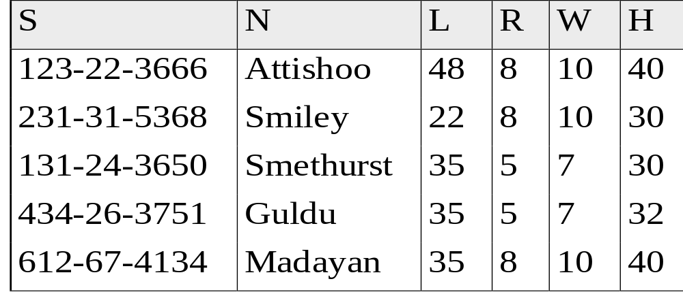
Example (same as before)
Hourly_Emps
SNLRWH has FDs S → SNLRWH and R → W
Q: Is this relation in BCNF?
No, The second FD causes a violation;
W values repeatedly associated with R values.

Slide 23
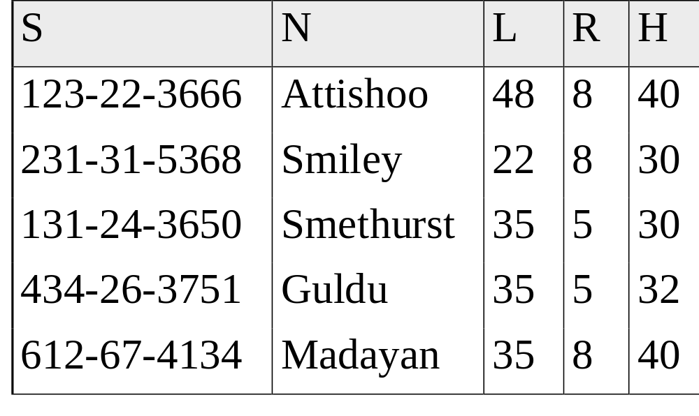

Decomposing a Relation
Easiest fix is to create a relation RW to store these associations, and to remove W from the main schema:
Wages
Hourly_Emps2
Q: Are both of these relations are now in BCNF?
Decompositions should be used only when needed.
  Q: potential problems of decomposition?

Slide 24
Problems with Decompositions
There are three potential problems to consider:
  1) May be impossible to reconstruct the original relation! (Lossiness)
    Fortunately, not in the SNLRWH example.
  2) Dependency checking may require JOINs.
    Fortunately, not in the SNLRWH example.
  3) Some queries become more expensive.
    e.g., How much does Guldu earn?
  Tradeoff: Must consider these issues vs. redundancy.

Slide 25

Lossless Decomposition (example)
=

Slide 26
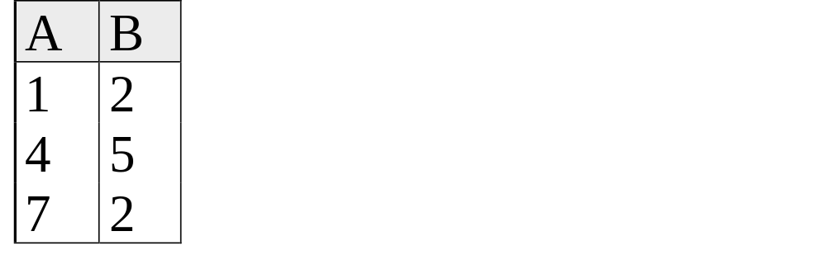
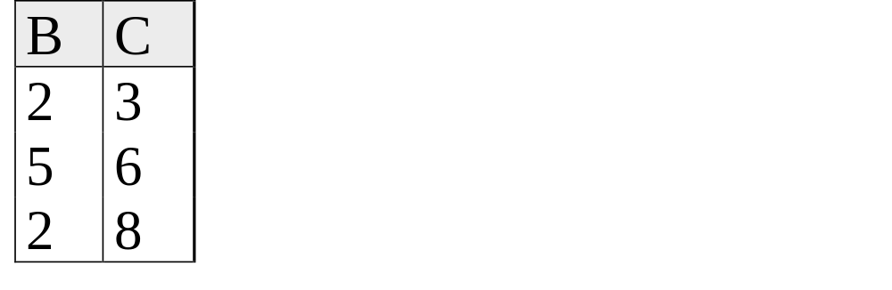
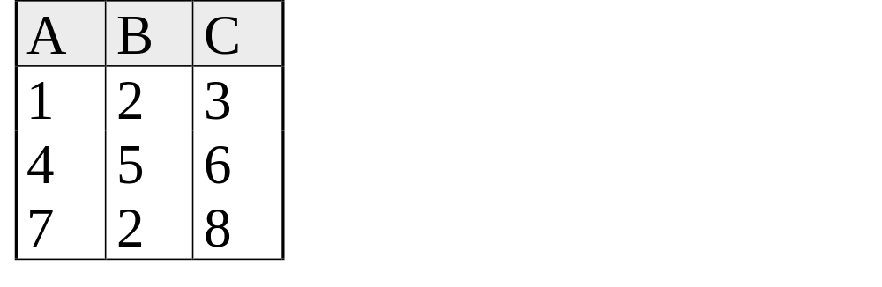
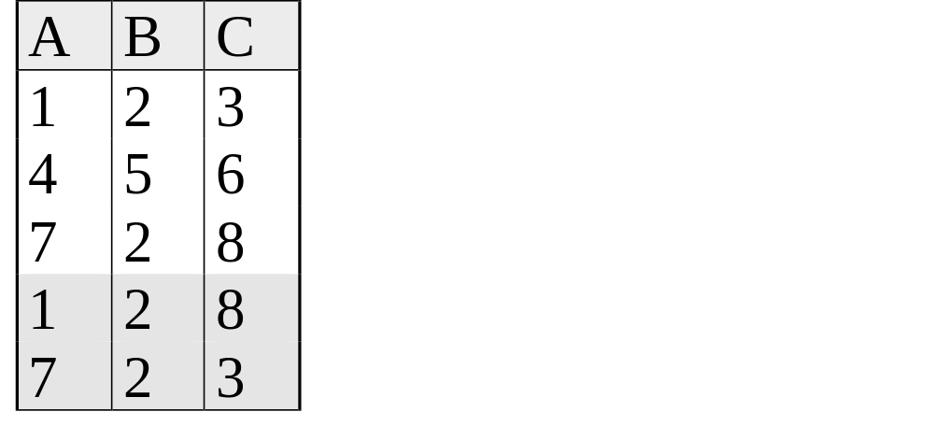
Lossy Decomposition (example)
A → B; C → B
=

Slide 27
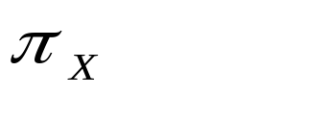
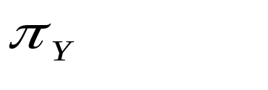

Lossless Join Decompositions
Decomposition of R into X and Y is lossless-join w.r.t. a set of FDs F if, for every instance r that satisfies F:
  (r) (r) = r
It is always true that r (r) (r)
  In general, the other direction does not hold! If it does, the decomposition is lossless-join.
Definition extended to decomposition into 3 or more relations in a straightforward way.
It is essential that all decompositions used to deal with redundancy be lossless! (Avoids Problem #1)

Slide 28
Simple Test on Lossless Decomposition
The decomposition of R into X and Y is lossless w. r. t. F iff the closure of F contains:
  X ∩ Y → X, or
  X ∩ Y → Y
In the example: decomposing ABC into AB and BC is lossy, because intersection (i.e., “B”) is not a key of either resulting relation.
Useful result: If W → Z holds over R and W ∩ Z is empty, then decomposition of R into R-Z and WZ is loss-less.

Slide 29
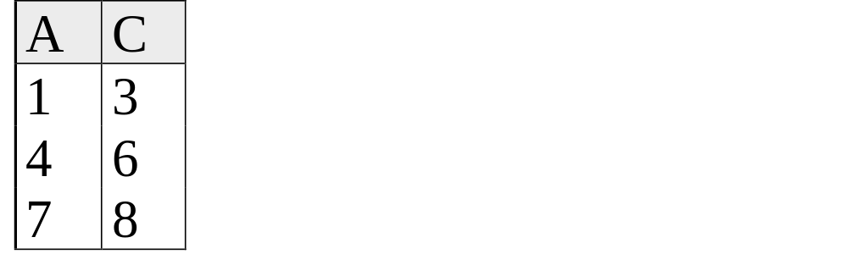
Lossless Decomposition (example)
A → B; C → B
=
But, now we can’t check A → B without doing a join!

Slide 30
Dependency Preserving Decomposition
Intuitively, a dependency preserving decomposition allows us to enforce all FDs by examining a single relation instance on each insertion or modification of a tuple.
  (Avoids Problem #2 on our list.)
Projection of set of FDs F :
  If R is decomposed into X and Y,
  the projection of F on X (denoted F_{X} ) is the set of FDs U → V in F⁺ such that all of the attributes U, V are in X. (same holds for Y of course)

Slide 31
Dependency Preserving Decompositions (Contd.)
Decomposition of R into X and Y is dependency preserving if (F_{X} ∪ F_{Y} ) ⁺ = F ⁺.
Important to consider F ⁺ in this definition:
  ABC, A → B, B → C, C → A, decomposed into AB and BC.
  Is this dependency preserving? Is C → A preserved?
    note: F ⁺ contains F ∪ {A → C, B → A, C → B}, so…
F_{AB} contains A →B and B → A; F_{BC} contains B → C and C → B .So, (F_{AB} ∪ F_{BC})⁺ contains C → A

Slide 32
Decomposition into BCNF
Consider relation R with FDs F. If X → Y violates BCNF, decompose R into R - Y and XY (guaranteed to be loss-less).
  Repeated application of this idea will give us a collection of relations that are in BCNF;
  lossless join decomposition, and guaranteed to terminate.
  e.g., CSJDPQV, key C, JP → C, SD → P, J → S
  {contractid, supplierid, projectid, deptid, partid, qty, value}
  To deal with SD → P, decompose into SDP, CSJDQV.
  To deal with J → S, decompose CSJDQV into JS and CJDQV
  So we end up with: SDP, JS, and CJDQV

Slide 33
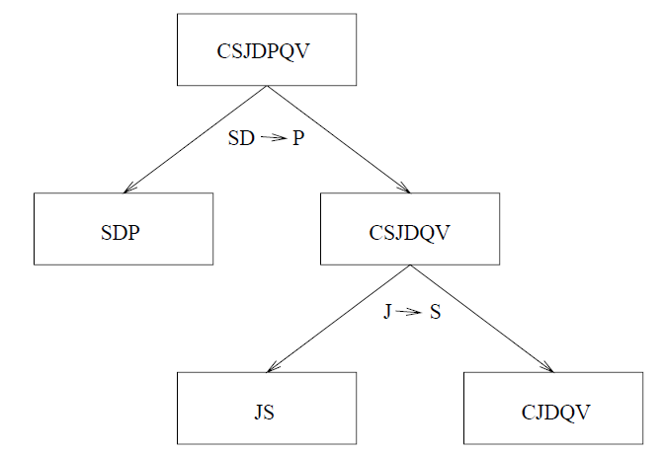
Decomposition of CSJDPQV into
SDP, JS, and CJDQV
What if we do the decomposition by using the dependency J→S first?

Slide 34
BCNF and Dependency Preservation
In general, there may not be a dependency preserving decomposition into BCNF.
  decomposition of CSJDPQV into SDP, JS and CJDQV is not dependency preserving (w.r.t. the FDs JP → C, SD → P and J → S).
  i.e., the dependency JP → C can not be enforced without a join. However, it is a lossless join decomposition.
In this case, adding JPC to the collection of relations gives us a dependency preserving decomposition.
  but JPC tuples are stored only for checking the FD. (Redundancy!)

Slide 35
Third Normal Form (3NF)
Relation R with FDs F is in 3NF if, for all X → A in F⁺
  A ∈ X (called a trivial FD), or
  X is a superkey of R, or
  A is part of some candidate key (not superkey!) for R.
Minimality of a key is crucial in third condition above!
If R is in BCNF, obviously in 3NF.
If R is in 3NF, some redundancy is possible. It is a compromise, used when no “good” decomposition for BCNF, or for performance considerations.
  Lossless-join, dependency-preserving decomposition of R into a collection of 3NF relations always possible.

Slide 36
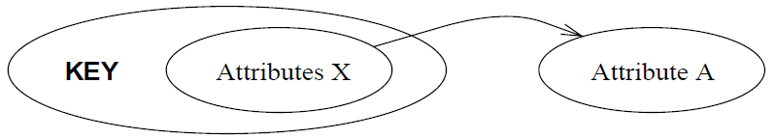
3NF Violated by X→A: Case 1
X is a proper subset of some key K
  Such X→A is sometimes called a partial dependency.
    We store (X, A) pairs redundantly.
    E.g., Reserves has attributes SBDC, (C is for credit card number), the only key is SBD, and we have the FD S → C.
    Then we store the credit card number for a sailor as many times as there are reservations for that sailor.

Slide 37

3NF Violated by X→A: Case 2
X is not a proper subset of any key.
  Such X→A is sometimes called a transitive dependency.
  Because it means there is a chain of FDs K → X → A.
The problem: we cannot associate an X value with a K value, unless we also associate an A value with an X value.
Example: SNLRWH has FDs S → SNLRWH and R → W

Slide 38
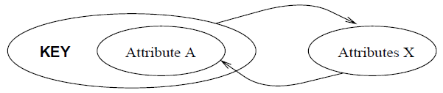
Redundancy in 3NF
The problems associated with partial and transitive dependences can persist in 3NF if
  There is a non-trivial FD X→A,
  and X is not a superkey,
  but A is part of a key.

Slide 39
Why 3NF?
The motivation for 3NF is rather technical.
  Lossless-join, dependency preserving decomposition does not always exist for BCNF.
  We can ensure every relation schema can be decomposed into a collection of 3NF relations
    using only lossless-join, dependency preserving decompositions.

Slide 40
Decomposition into 3NF
The algorithm for lossless join decomposition into BCNF can be used to obtain a lossless join decomposition into 3NF
  but does not ensure dependency preservation.
To ensure dependency preservation, one idea:
  If X → Y is not preserved, add relation XY.
  Problem is that XY may violate 3NF!
  e.g., consider the addition of JPC to `preserve’ JP → C. What if we also have J → C ?
Refinement: Instead of the given set of FDs F, use a minimal cover for F.

Slide 41
Minimal Cover for a Set of FDs
Minimal cover G for a set of FDs F:
  F⁺ is equal to G⁺.
  Each FD in G is of the form X→A, where A is a single attribute.
  If we modify G by deleting an FD or by deleting attributes from an FD in G, the closure changes.
Intuitively, every FD in G is needed, and ``as small as possible’’ in order to get the same closure as F.

Slide 42
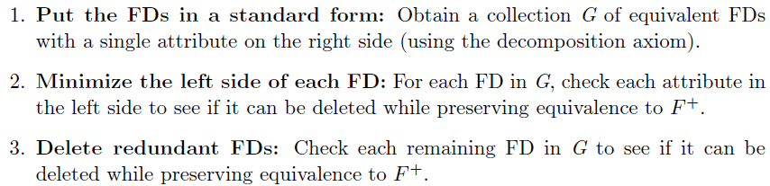
A General Algorithm for Calculating Minimal Cover
E. g., Assume F = {A → B, ABCD → E, EF → GH, ACDF → EG}, its minimal cover is:
  A → B, ACD → E, EF → G and EF → H

Slide 43
Dependency-Preserving Decomposition into 3NF
Let R be a relation with a set of F of FDs that is a minimal cover, and let R₁, R₂, …, R_{n} be a lossless-join decomposition of R.
Suppose that each R_{i} is in 3NF, and let F_{i} denote the projection of F onto the attributes of R_{i}.
Do the following:
  Indentify the set N of FDs in F that are not preserved.
  For each FD X→A in N, create a relation schema XA and add it to the decomposition of R.
    Each XA is in 3NF.

Slide 44
Proof: XA is in 3NF
Since X→A is in the minimal cover F,
  For any proper subset Y of X, Y→A does not hold.
  Therefore, X is a key for XA.
For any other FD P→Q that holds over XA
  Q must belong to X.

Slide 45
Summary of Schema Refinement
BCNF: each field contains information that cannot be inferred using only FDs.
  ensuring BCNF is a good heuristic.
Not in BCNF? Try decomposing into BCNF relations.
  Must consider whether all FDs are preserved!
Lossless-join, dependency preserving decomposition into BCNF impossible? Consider 3NF.
  Same if BCNF decomp is unsuitable for typical queries
  Decompositions should be carried out and/or re-examined while keeping performance requirements in mind.

